Slide 1

Churn Rate Analysis & Predictions
Data Science Tools II
Final Project Presentation
by Brenda Woodard

Slide 2
Purpose of Analysis & Research Question
This dataset is unique and interesting to me because I work in the media industry with similar data, albeit in a somewhat different capacity.
Research question to be answered through my analysis:
Determine which variables have the greatest effect on whether a customer will be retained or lost, aka churned.
Note: Since the dataset contains categorical data this will be a supervised learning problem.

Slide 3
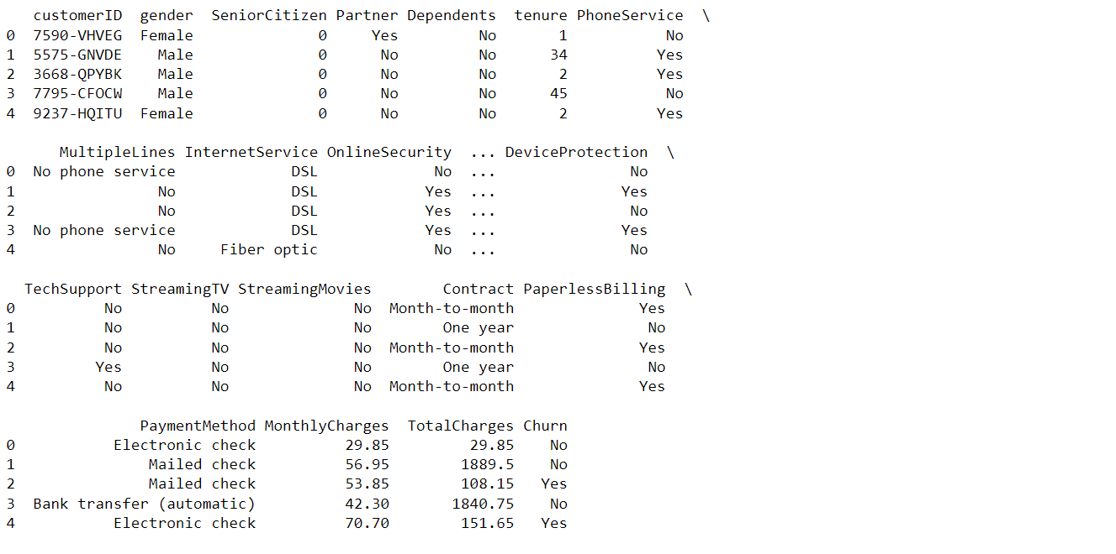
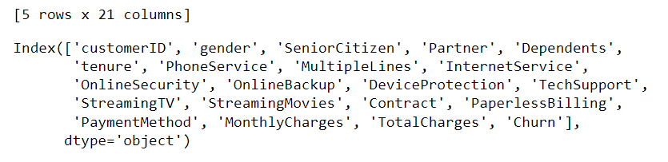
Description of Dataset & Source
This dataset was created to be used as a tool in predicting customer behaviors in order to retain that customer. Each row of the data represents 1 customer, and each column contains customer attributes. By analyzing the relevant customer data you could develop programs to decrease the loss of customers.
Data set head:
Data set size & columns:
Source Info: https://www.kaggle.com/blastchar/telco-customer-churn

Slide 4
Description of input & output variables in the dataset
The input variables are described as follows:
customerID is an identifying number unique to each customer
gender, SeniorCitizen, Partner, & Dependents contain demographic information about the customer
PhoneService, MultipleLines, InternetService, OnlineSecurity, OnlineBackup, DeviceProtection, TechSupport, StreamingTV, & StreamingMovies are all the services a customer is, or is not, signed up for
tenure, Contract, PaperlessBilling, PaymentMethod, MonthlyCharges, & TotalCharges contain customer account information
Output variable:
Churn is the final column, and it represents the customers who left within the last month

Slide 5
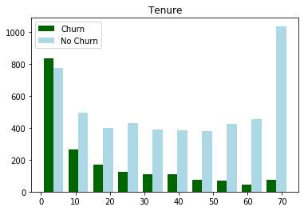
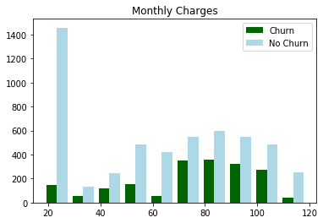
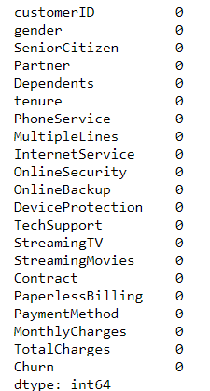
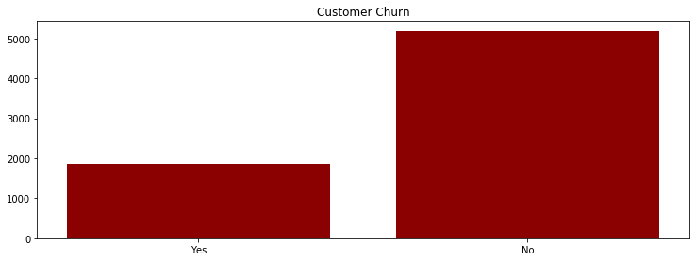
Data Preprocessing
Visualizing Numerical Attributes:
Shows the longer the customer has the service, the less likely they are to churn
Shows customer is more likely to churn if they have higher monthly charges
Checked for missing data
Shows that there is a high percentage of churn

Slide 6
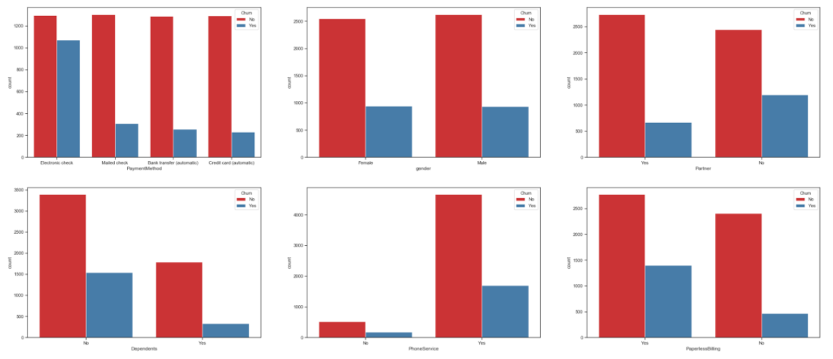
Visualizing the Categorical Attributes

Slide 7
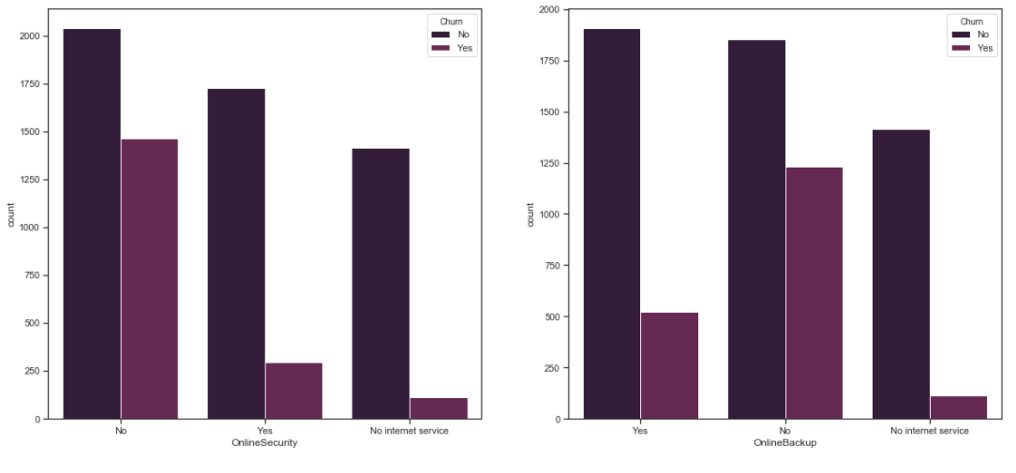
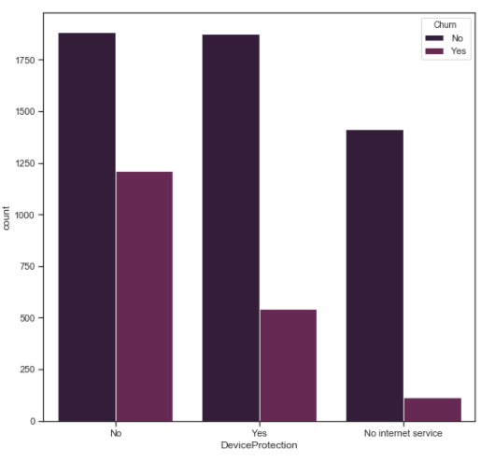
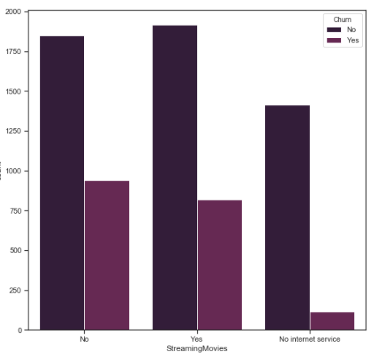
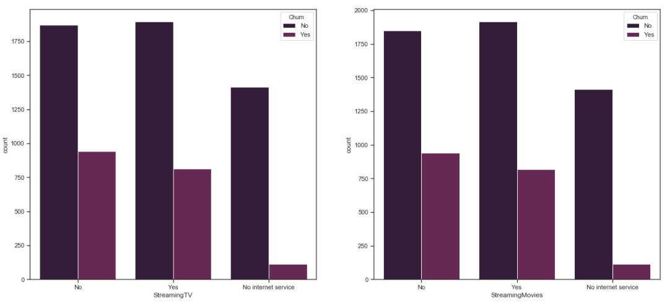
Visualizing the Categorical Attributes Cont.

Slide 8
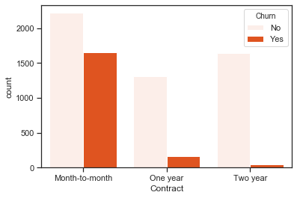
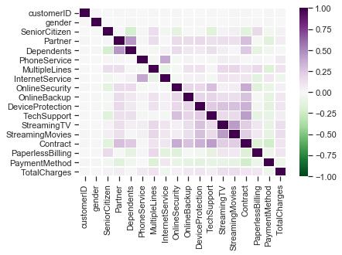
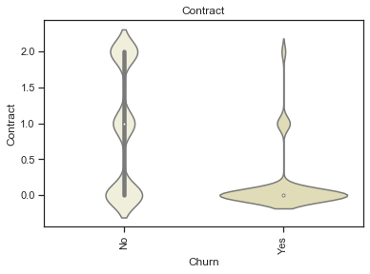
Data Visualization and Splitting
Correlation Heatmap
Visualizing Contract vs Churn
Splitting Code Snippet:
Y = churn_data['Churn']
data = cat_cols.drop('customerID', axis = 1)
x_train, x_test, y_train, y_test = train_test_split(data, Y, test_size=0.25, random_state=2)
print('x_test = ' + str(x_test) )
print('y_test = ' + str(y_test) )
Data Description:
 | customerID | gender | SeniorCitizen | Partner | Dependents | PhoneService | MultipleLines | InternetService | OnlineSecurity | OnlineBackup | DeviceProtection | TechSupport | StreamingTV | StreamingMovies | Contract | PaperlessBilling | PaymentMethod | TotalCharges
count | 7043.000000 | 7043.000000 | 7043.000000 | 7043.000000 | 7043.000000 | 7043.000000 | 7043.000000 | 7043.000000 | 7043.000000 | 7043.000000 | 7043.000000 | 7043.000000 | 7043.000000 | 7043.000000 | 7043.000000 | 7043.000000 | 7043.000000 | 7043.000000
mean | 3521.000000 | 0.504756 | 0.162147 | 0.483033 | 0.299588 | 0.903166 | 0.940508 | 0.872923 | 0.790004 | 0.906432 | 0.904444 | 0.797104 | 0.985376 | 0.992475 | 0.690473 | 0.592219 | 1.574329 | 3257.794122
std | 2033.283305 | 0.500013 | 0.368612 | 0.499748 | 0.458110 | 0.295752 | 0.948554 | 0.737796 | 0.859848 | 0.880162 | 0.879949 | 0.861551 | 0.885002 | 0.885091 | 0.833755 | 0.491457 | 1.068104 | 1888.693496
min | 0.000000 | 0.000000 | 0.000000 | 0.000000 | 0.000000 | 0.000000 | 0.000000 | 0.000000 | 0.000000 | 0.000000 | 0.000000 | 0.000000 | 0.000000 | 0.000000 | 0.000000 | 0.000000 | 0.000000 | 0.000000
25% | 1760.500000 | 0.000000 | 0.000000 | 0.000000 | 0.000000 | 1.000000 | 0.000000 | 0.000000 | 0.000000 | 0.000000 | 0.000000 | 0.000000 | 0.000000 | 0.000000 | 0.000000 | 0.000000 | 1.000000 | 1609.000000
50% | 3521.000000 | 1.000000 | 0.000000 | 0.000000 | 0.000000 | 1.000000 | 1.000000 | 1.000000 | 1.000000 | 1.000000 | 1.000000 | 1.000000 | 1.000000 | 1.000000 | 0.000000 | 1.000000 | 2.000000 | 3249.000000
75% | 5281.500000 | 1.000000 | 0.000000 | 1.000000 | 1.000000 | 1.000000 | 2.000000 | 1.000000 | 2.000000 | 2.000000 | 2.000000 | 2.000000 | 2.000000 | 2.000000 | 1.000000 | 1.000000 | 2.000000 | 4901.500000
max | 7042.000000 | 1.000000 | 1.000000 | 1.000000 | 1.000000 | 1.000000 | 2.000000 | 2.000000 | 2.000000 | 2.000000 | 2.000000 | 2.000000 | 2.000000 | 2.000000 | 2.000000 | 1.000000 | 3.000000 | 6530.000000

Slide 9
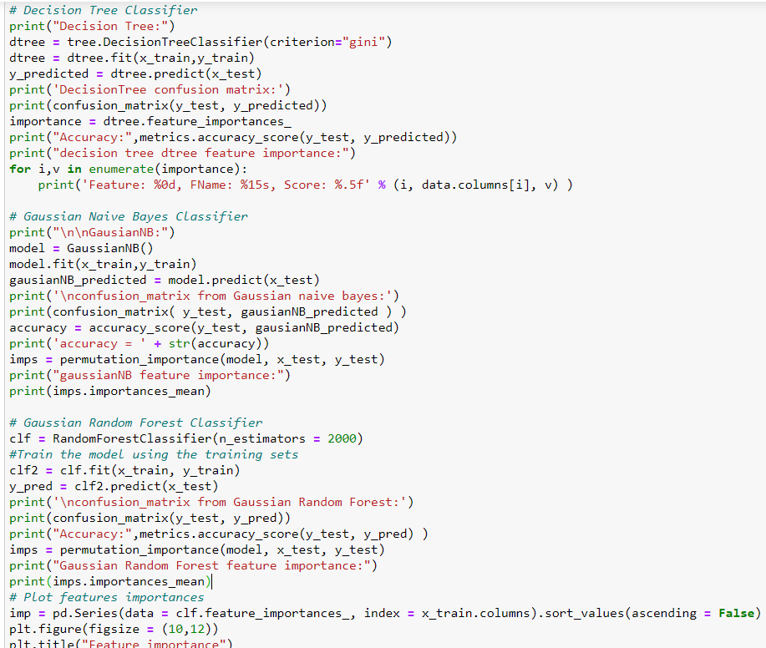
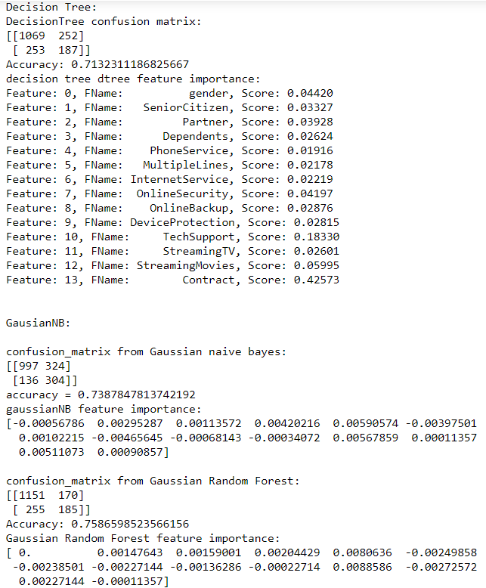
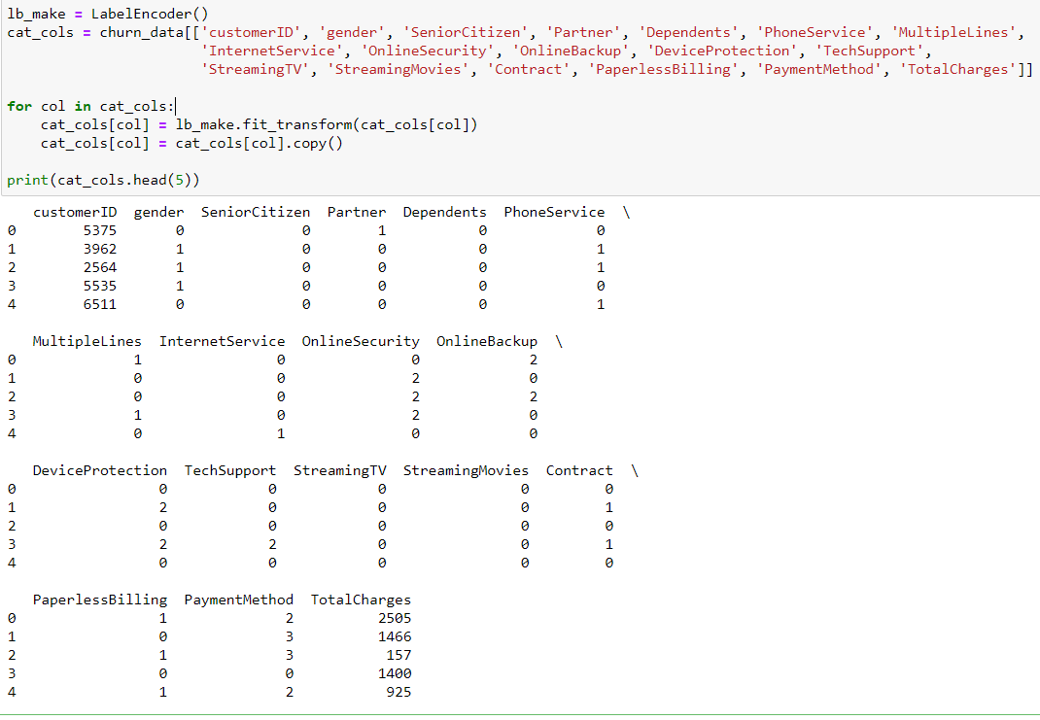
Screenshots of algorithms/code for building the model
Snippets:

Slide 10
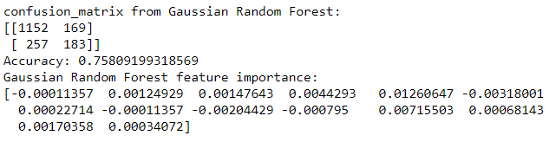
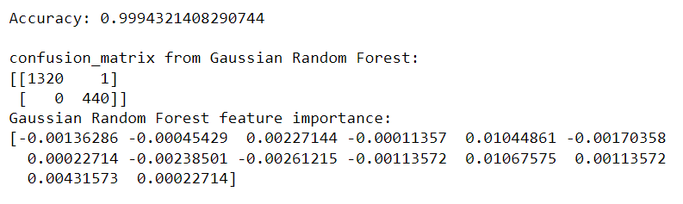
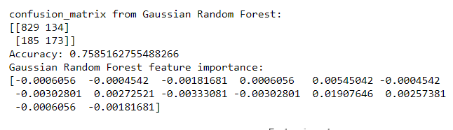
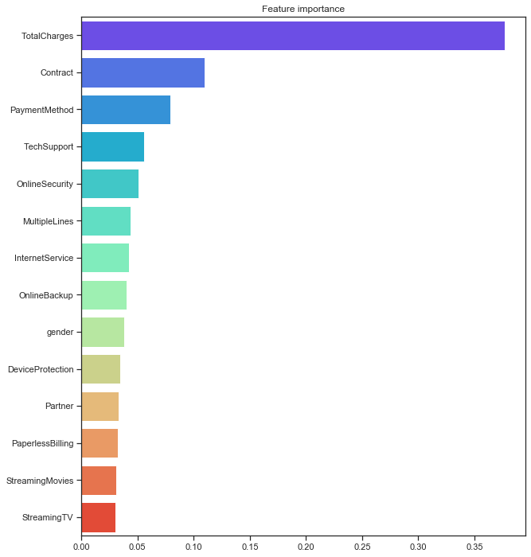
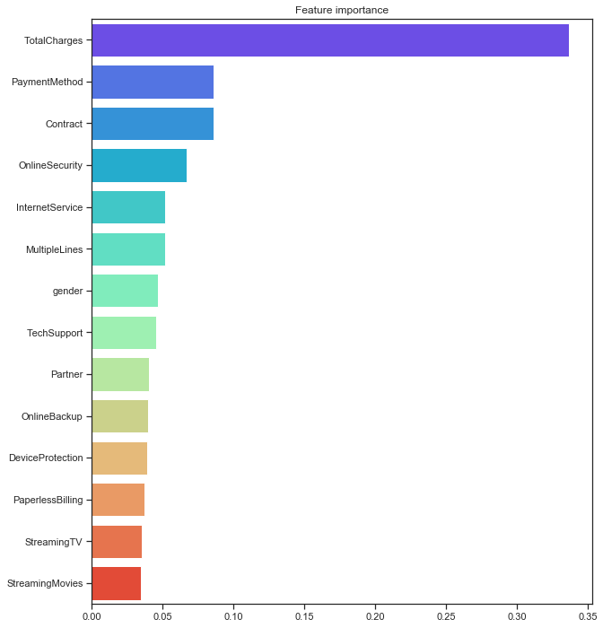
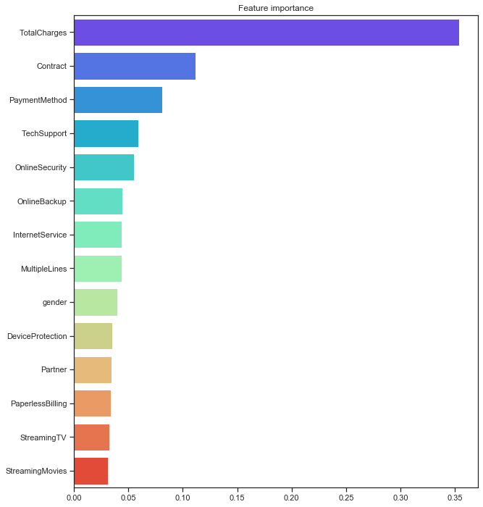
Model selection & model evaluation—performance measures, graphs, & so forth
Results from running the model on the test set:
Results from running the model on the test set:
Results from running the model on the validation set

Slide 11
Conclusion
From the results of the training and validation datasets it is clear the Gaussian Random Forest classifier performed the best for this dataset. As a result, I implemented the Random Forest algorithm on the test dataset and the results were a 99% accuracy score. This implies that the model is subject to overfitting since the results were more accurate on the test data than on the training data.
To improve this model, and fix the overfitting, I would implement cross-validation before running the algorithms.
Churn rate is becoming one of the most pressing issues the large media companies are facing today. I was also able to isolate the different attributes and the effect that they have on the overall data. The attributes that contributed the most to customers leaving were the TotalCharges, Contract and PaymentMethod categories, with TotalCharges having a decidedly bigger influence than any of the other features.

